Slide 1
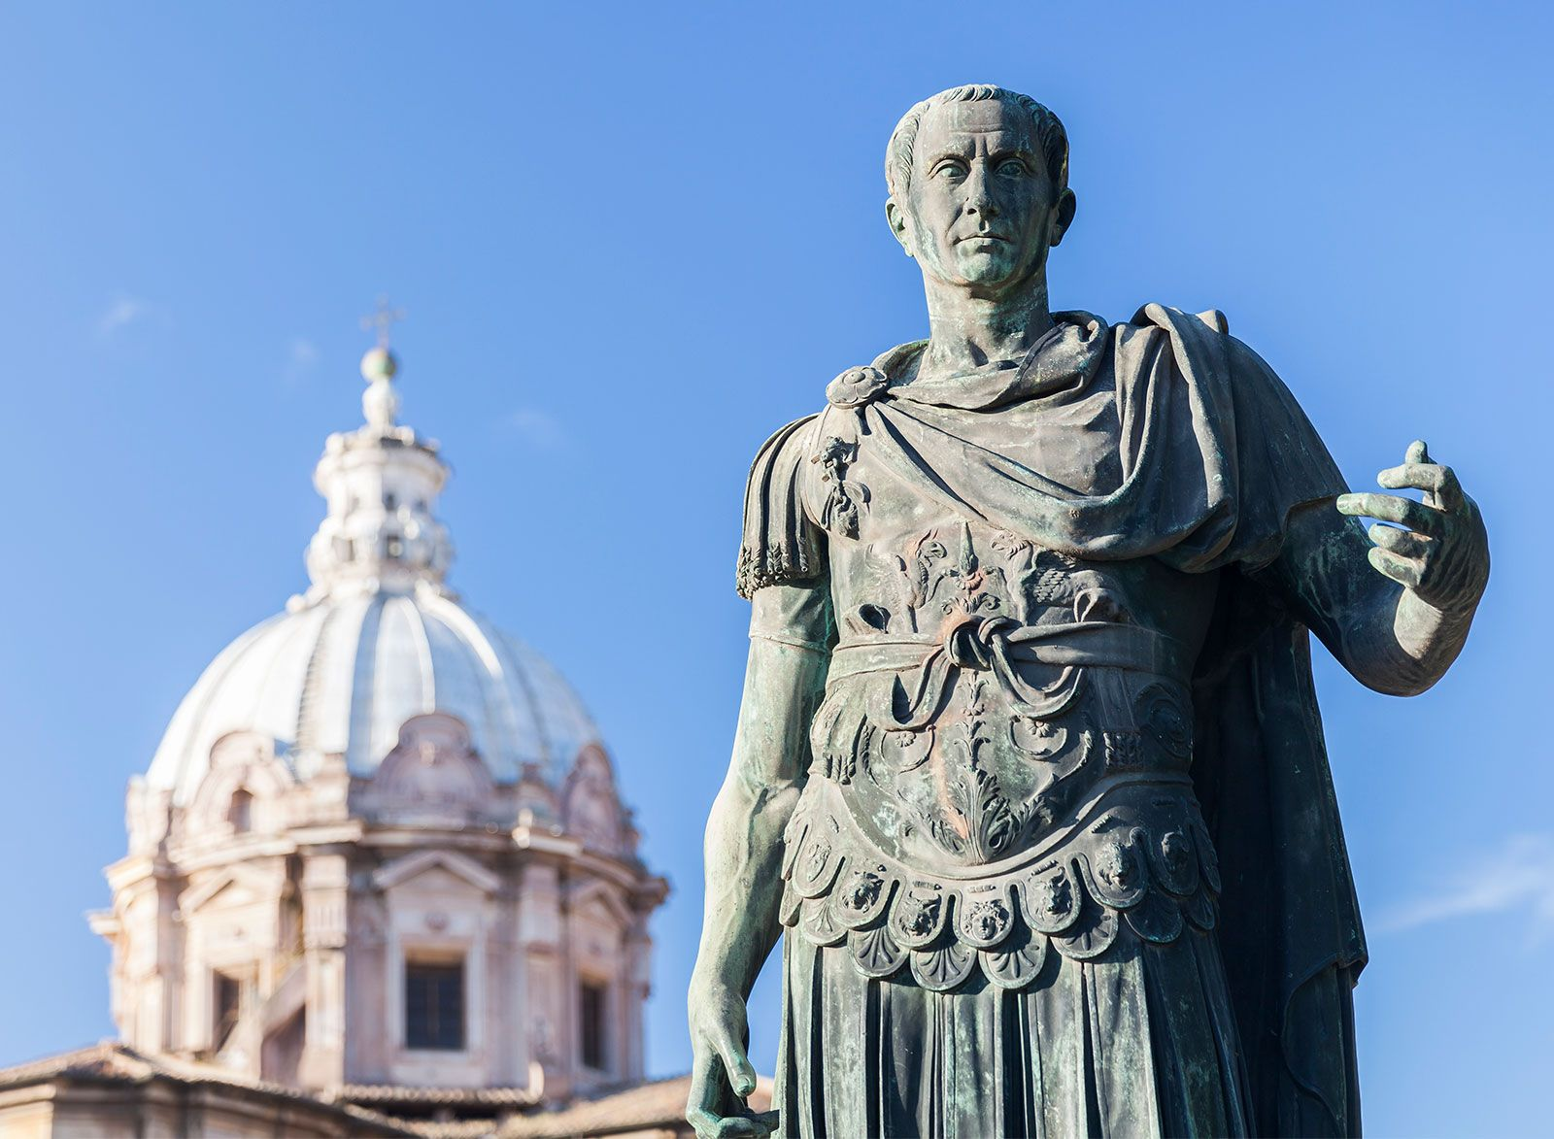
The First Triumvirate
- Describe the aims and motivations of the First Triumvirate
Week 7 Lesson 1
Ms Barrie

Slide 2
REVIEW – Julius Caesar
RETEACH
Read the following bold and underlined words aloud as a class
_____________________________________________________________________________
Gaius Julius Caesar was born in 100 BCE, as is known for launching a series of political and social reforms before being assassinated by a group of nobles.
He conquered Gaul between 58 and 50 BCE, was a victor in a civil war between 49 and 45 BCE, and held the position of ‘Dictator’ from 46 to 44BCE.
He was a member of the first triumvirate, a political institution ruled or dominated by three individuals.

Slide 3
REVIEW – Julius Caesar
RETRIEVE
Fill in the blanks
_____________________________________________________________________________
The three members of the first TRIUMVIRATE are:
1:_______________________________________
2:_______________________________________
3:_______________________________________
It was created in _______ BCE
Notes:
It was created in 60 BCE by Gaius Julius Caesar, Gnaeus Pompeius Magnus (known as Pompey 'the Great'), and Marcus Licinius Crassus.

Slide 4
REVIEW – Julius Caesar
APPLY
Finish the sentences.
_____________________________________________________________________________
Caesar’s aims were…
Pompey’s aims were…
Crassus’ aims were…
Notes:
Caesar – consulship
Pompey – veterans to be rewarded with land
Crassus - dignity in a military command but also sought to recoup money he and his fellow investors had lost during the food crises in the east.

Slide 5
This week:
The First Triumvirate – what happened?
Gallic Wars
The Civil Wars
Assassination/The Second Triumvirate

Slide 6
Each of the three men faced unsurmountable challenges that could not be resolved alone. Their difficulties were public knowledge and there was significant tension in Rome about what would happen. However, it was Julius Caesar who realised that the three men could actually use their individual strengths to help each other out.

Slide 7
How was the alliance formed?
60 BCE, Caesar invited Crassus and Pompey to a secret meeting
Caesar promised that, if he became consul, he would ensure that legislation would be enacted that would solve both Crassus' and Pompey's problems.
In return, he needed Crassus' money to pay for votes and Pompey's soldiers to intimidate voters on the day to ensure Caesar won.
The most difficult part of this agreement was the fact that Pompey and Crassus hated each other.
Ever since Pompey had unfairly stolen Crassus' triumph at the end of the Spartacus revolt, the two men had been direct opponents.
However, Caesar was able to encourage the two to overlook their personal animosities in order to work together.
Once the agreement had been reached, the three men knew that what they were doing was considered highly illegal in Roman politics and the three men swore to keep their arrangement secret for as long as they could.
Notes:
Since this discussion was secret, the exact details of what was decided is unknown. However, based upon what would happen over the next two years, historians can confidently identify the terms of their agreement.

Slide 8
Caesar is CONSUL!
Successful in achieving their goals!
The first order of business for the First Triumvirate was to get Caesar elected as consul.
bribing the voters
using Pompey's military strength to intimidate anyone who opposed their candidate.
Caesar elected as consul for 59 BCE
used his position as consul to pass a series of laws that increased his own power and weakened the Senate.
Caesar passed laws that gave him some public land to Pompey's veterans and arranged tax breaks for Crassus' wealthy friends.
The secret agreement had been a success and the three men were able to control Roman politics for an entire year. However, people began to work out what had happened, and the Senate became suspicious.

Slide 9
Caesar is … NOT CONSUL!
When Senators began calling for the three men to be held accountable for illegally manipulating Roman politics, Caesar, Pompey, and Crassus had to find some solutions.
Caesar used his position as consul to pass a law that gave him command of Rome's armies in Gaul.
This meant that he would be away from Rome for five years, which suited Pompey and Crassus just fine.
They did not want Caesar around while they worked on consolidating their power. It also meant that Caesar could not face legal proceedings for illegal actions during his consulship. He was immune from this until his military command expired.
Crassus and Pompey continued to use their political power and money to put their allies in the consulships for the next year, on the understanding that they would also be kept safe from any legal charges.

Slide 10
ACTIVITY – Things begin to unravel
Read through the text and complete the activity sheet provided.
SUMMARY:
Outline how the Triumvirate formed and their own aims/motivations.

